Slide 1
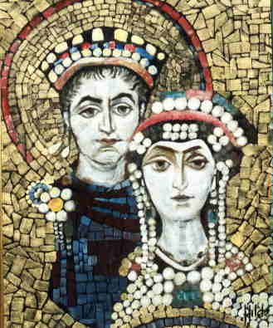
Byzantine & Russian Empires

Slide 2
The Roman Empire divided in 294

Slide 3
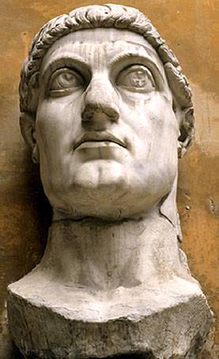
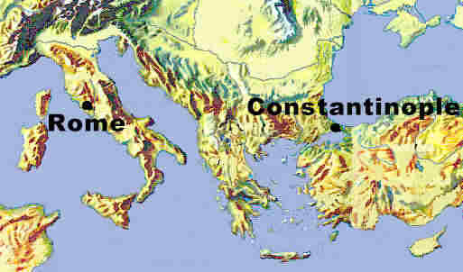
Constantine’s City Constantinopolis

Slide 4
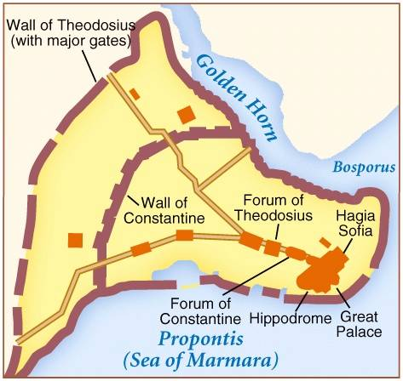
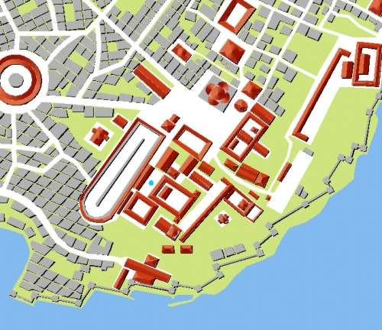
Constantinople: A Greek City (Istanbul Today)

Slide 5
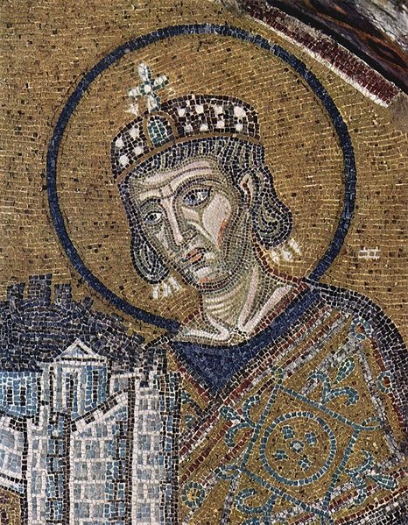
Schisms in the Christian Church
Council of Nicaea
Called by Constantine 325
Settle disputes over doctrine
Question on nature of Jesus (human → divine or just divine)
Established the Holy Trinity
Schism between Roman & Egyptian Bishops (Coptic)
Evaluated role of Mary & Mary Magdalene (prostitute)
392 Olympics banned
730—Iconoclasts—Leo III—back 843

Slide 6
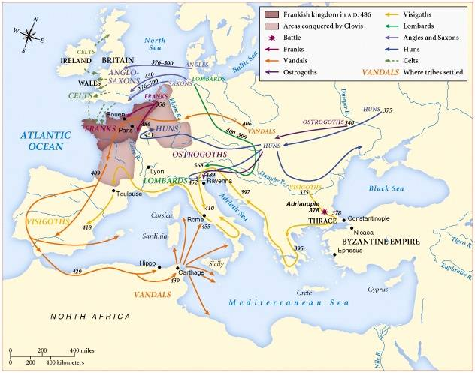
Barbarian Invasions of the Roman Empire

Slide 7
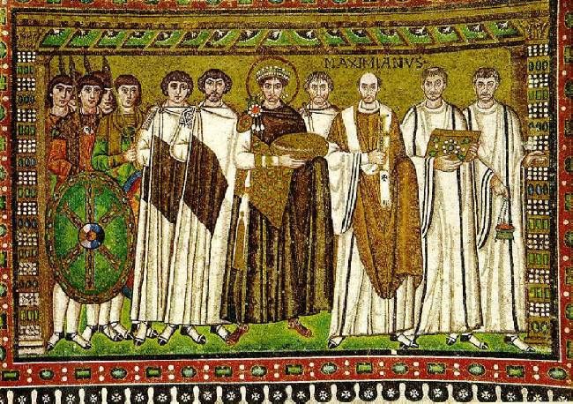
Emperor Justinian [r. 527-564]
Mosaic of Emperor Justinian and his Attendants
San Vitale in Ravenna, Italy ca. 547 A.D.

Slide 8
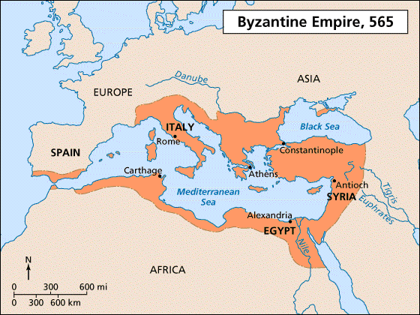
Byzantine Golden Age
Justinian’s Code
Women/slaves ordinary people protected
Civil laws
Heavy taxes to rebuild Constantinople
Hagia Sophia
Belisarius → Reconquered much of old Roman Empire
Theodora set precedent-women rule with husband
Play

Slide 9
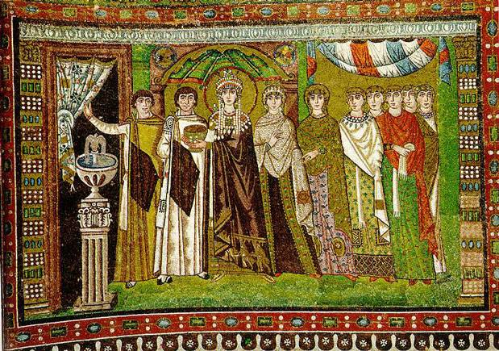
Empress Theodora
Mosaic of Empress Theodora and her Attendants
San Vitale in Ravenna, Italy ca. 547 A.D.

Slide 10
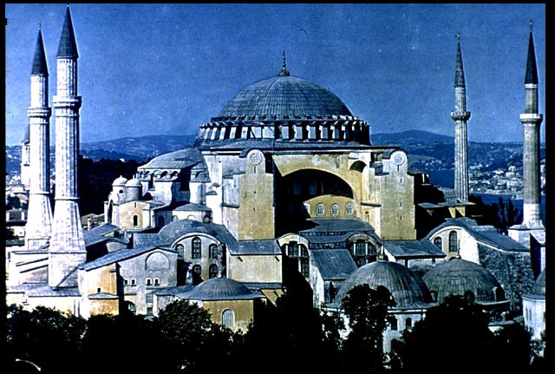

Slide 11
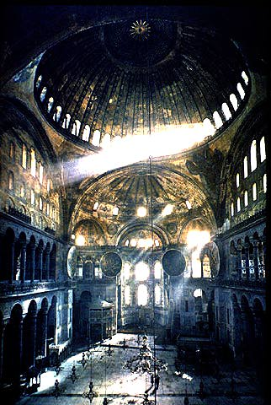

Slide 12
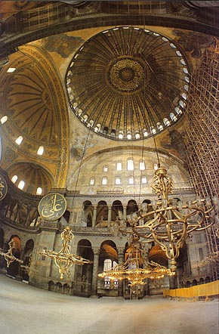

Slide 13
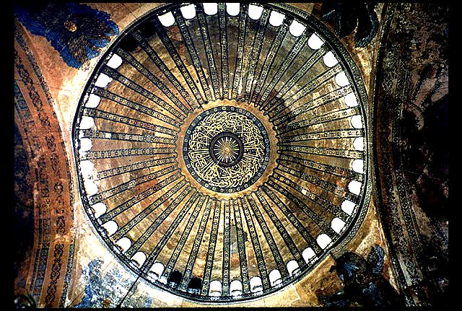

Slide 14
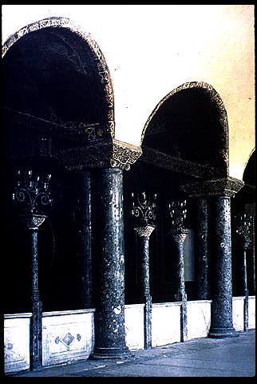
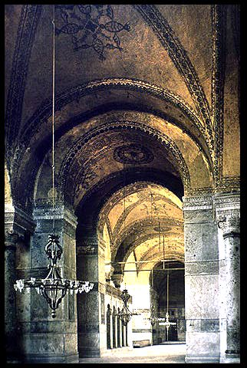

Slide 15
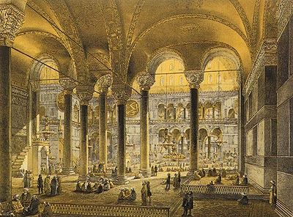

Slide 16
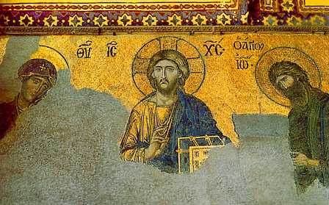
The Deesis, 13th century A.D.
Hagia Sophia

Slide 17
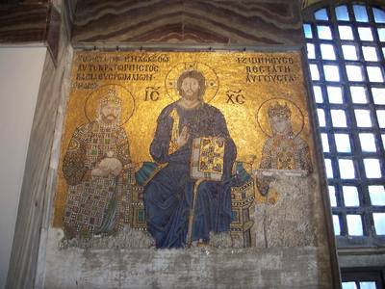
Christ with Emperors Justinian and Constantine
Hagia Sophia

Slide 18
Byzantine Culture and Economy
Preserved Greco-Roman Culture
Greek instead of Latin
Religious Art: icons, illustrated manuscripts, mosaics
Missionaries spread Christianity & Byzantine culture to Slavs & Russians
Cyril & Methodius Alphabet
Women confined/ vailed
Economy:
Crossroads between East & West
Diverse cultures
Emperors controlled prices & industries
Stole silk worms from China
rural economy
-farmers still used slow oxcart/plow

Slide 19
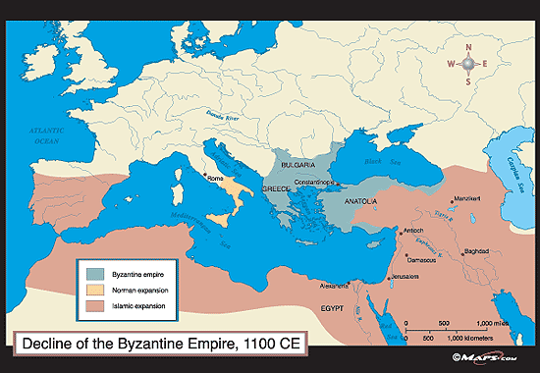
Collapse of Byzantine Empire
Frequent Invasions:
Germans: Italy, Sp, North Africa,
Arabs: North Africa,
Seljuk Turks: much of Anatolia, & Fertile Crescent
Plagues every 8-12 years
Inefficient emperors
Crusaders-1204-57 Latin Empire
Mongol invasions of Russia—trade weakened
Ottoman Turks—Conquered Byzantine Empire in 1453

Slide 20
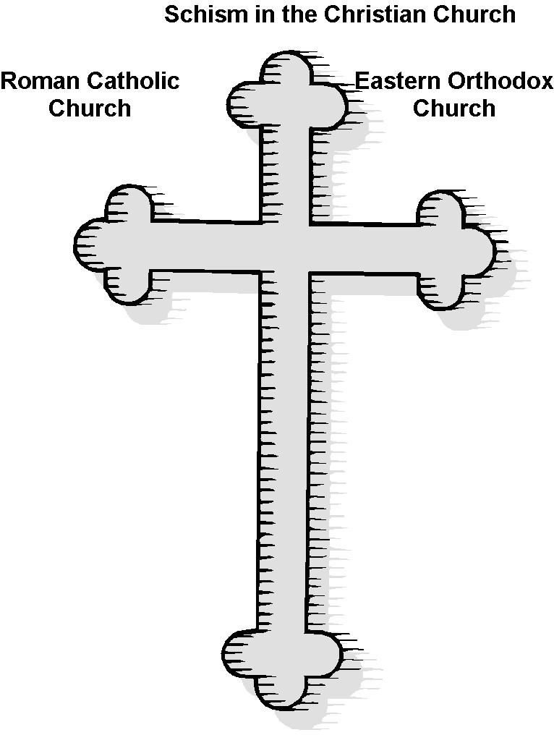
Head: Pope
HQ: Rome/ Vatican
Head: Patriarch
HQ: Constantinople
Language: Latin
Power: Pope’s authority over all church matters & all kings and emperors
Priests: may NOT marry
Divorce: NOT permitted
Icons: permitted
Bible: “Western Bible”
Greek / Vernacular
Patriarch shares power with other clergy—no power over emperors
May marry
Divorce: Permitted
Icons at 1st seen as idolatry, later allowed
Add’l books to Western Bible

Slide 21
Rise of Russia
Three cultures laid the foundation for Russia
People=Slavs
Ideas from Greeks/Byzantine
Christianity
art/arch
Vikings conquered
Rurik the Rus invited to rule Kiev
Russia named for tribe

Slide 22
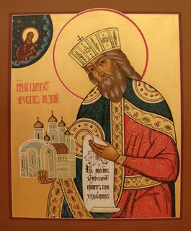
Kiev
Located along the Dneiper R—good for trade (Constantinople)
Vladimir converted to Christianity (EOC) 988
Yaroslav the Wise -- Golden Age 1019
-Married female relatives off to expand empire
-Legal code (similar to ___)
-Split empire between sons

Slide 23
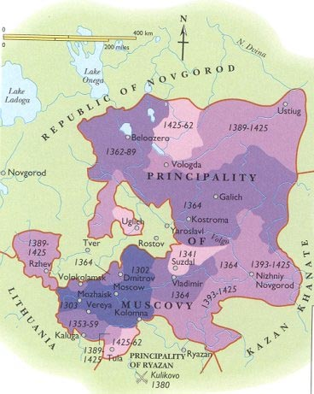
Moscow
Located around 3 rivers—trade
Principality of Muscovy
Cooperated with Mongols
Alexander Nevsky
Ivan I—The Moneybags
Collected taxes for the Mongols

Slide 24
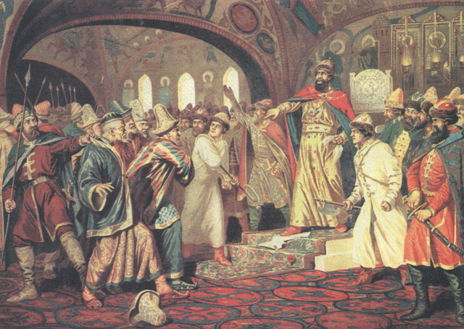
Ivan III (r. 1440-1505)
Ivan the Great
Defeated Mongols, 1472
Creates Russia’s 1st empire
Takes title “Czar”
1480:Ivan reject the diplomatic gestures of the Khan, refuses to continue to pay tribute.

Slide 25
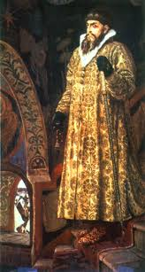
Ivan IV (r. 1530-1584)
Age 4 when became king
Regency of Boyars
16 → claimed throne for self → crowned czar
Continues to push Mongols east
Builds St. Basil’s Cathedral to commemorate victories
Goes mad → paranoid schizophrenic
Kills boyars (including son)
Treats peasants poorly
Becomes known as Ivan the Terrible

Slide 26
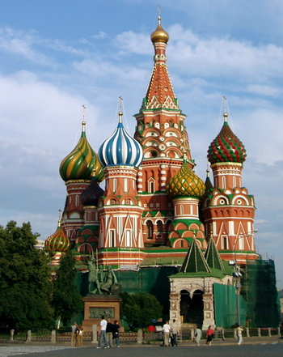
St. Basil’s Cathedral in Moscow—commemorates the victories over the Mongols

Slide 27
Mongol Invasions – Genghis Khan
Enslaved, killed pillaged
Fair ruler
Obey few laws
Pay tribute
Conquest hurt Byzantine Empire when Kiev was conquered
trade cut off
Silk Road became unused for a time
Conquest hurt Russia by isolating them from Western Europe
became stagnant– no Renaissance/Scientific Revolution

