Slide 1
Ancient
China

Slide 2
Neolithic
China

Slide 3
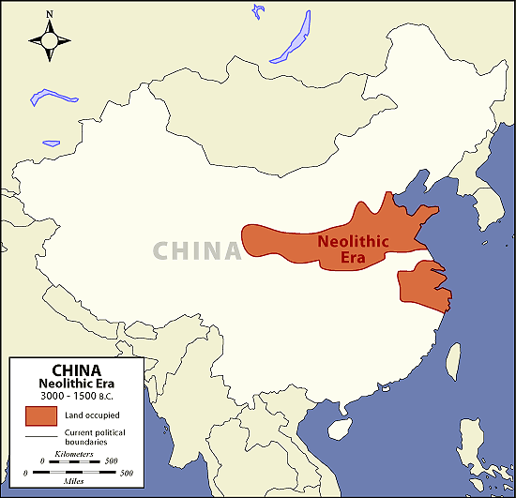
Yellow River Civilization

Slide 4
The Earliest Settlements -1
8000 BCE, Neolithic pottery in China’s western Henan province; also discovered a set of tiny flutes made from the wing bones of a large bird.
Farmers grew millet, wheat and rice and domesticated pigs, dogs, goats, and maybe horses.
They lived in river valleys and had walls for defense.
Warriors used chariots to defeat their enemies.

Slide 5
The Earliest Settlements -2
Out of these early villages, larger political units gradually emerged.
Ancient Chinese historical texts tell of three early dynasties: the Xia, the Shang, and the Zhou.
State formation may have begun under the Xia, 2205-1766 BCE
All were based primarily around the Huang He (Yellow River) valley in north China.

Slide 6
The Yellow River (Huang He)
The Huang He River takes its name from the vast quantities of loess which gathers along its route from the high mountains of Tibet to its mouth as it empties into the Yellow Sea.

Slide 7
The Yellow River (Huang He)
Sometimes there was unpredictable flooding.
Frequent rainfall made vast irrigation systems unneeded.
Early people did dredge the river bed to reduce the frequency of flooding.
Such projects helped initiate early governments.

Slide 8
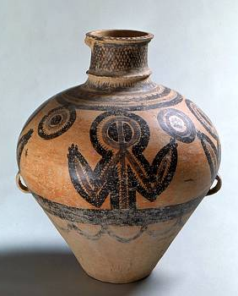
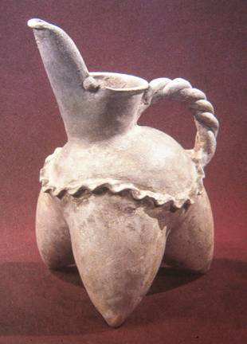
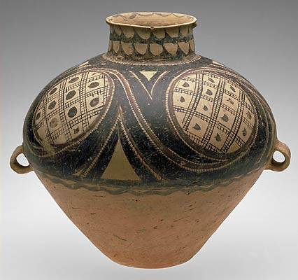
Neolithic Pottery
3000 BCE to 2000 BCE

Slide 9
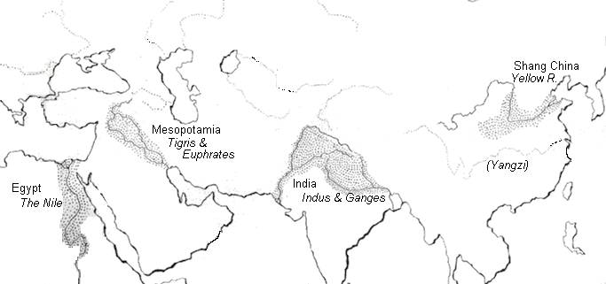
The 4 Old-World River Valley Cultures

Slide 10
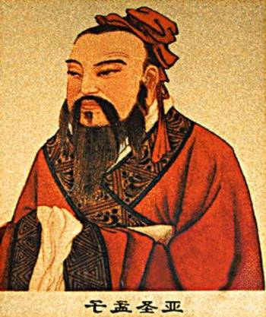
The Four Thousand Years of Civilization
Chinese civilization extends backwards in history in an unbroken chain for nearly four thousand years. Throughout this time, the Chinese people have been instrumental in developing new technologies and advancing human knowledge.

Slide 11
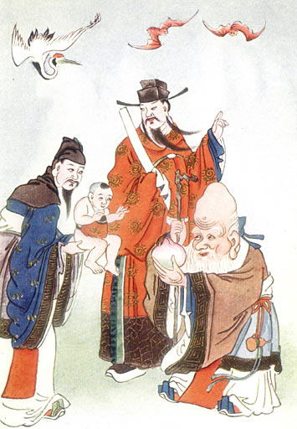
Dynasties
The Chinese have been ruled by a succession of dynasties (families that pass the right to rule the nation from one generation to the next).
Xia (Hsia) Dynasty 2205-1766 BCE
Shang Dynasty 1766-1122 BCE
Zhou Dynasty 1122-256 BCE

Slide 12
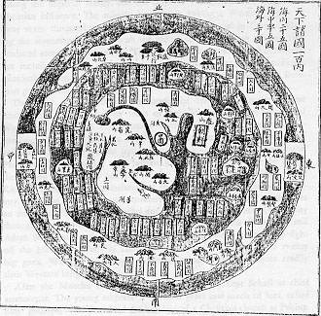
“Chung Kuo” (The “Middle Kingdom”)

Slide 13
Dynasties
Records about the Xia Dynasty are sparse.
Archaeological records on the urbanization under the Shang is revealing and reliable.
The Zhou consolidated both city and state and left extensive archaeological remains and written records.
Traditional chronological dating suggests that the states succeeded one another but recent evidence indicates considerable overlap.
They may have coexisted in neighbouring regions.
Notes:
The earliest and to-date most well known Shang site is Anyang in Henan province. Work began in 1928 initially as an investigation of the source of oracle bones. It was carried out by a team from the new research organisation Academia Sinica, and directed by the Harvard-trained anthropologist Li Ji. Fifteen seasons of excavation were carried out at Anyang until 1937, when the Second Sino-Japanese War forced the archaeologists to evacuate. During that time, the Anyang excavators uncovered large pounded-earth (hangtu) architectural foundations, sacrificial burial cemeteries, and gigantic shaft tombs, not to mention caches of bronze vessels. Historians have come to associate the site with the tradition name Yinxu, the Shang capital for the last twelve kings of the dynasty, starting with Pan Geng. Excavations at Anyang resumed in 1950, under the auspices of a new Institute of Archaeology, and a permanent field station was established there in 1958.
The successes at Anyang encouraged further archaeological efforts, awareness of which has been fostered by the State Bureau of Cultural Relics. In 1952, excavations at Erligang, near Zhengzhou, disclosed the remains of a walled city at least as large as Anyang, but from a demonstrably earlier period. Excavations were difficult, however, because the ancient city lay beneath the modern one.
The still older site of Erlitou, near Luoyang, was discovered in 1959 by a survey prospecting for Xia remains. The three sites of Erlitou, Erligang, and Anyang have been taken to provide a complete chronological sequence for the early Bronze Age in China.
There have also been other finds away from the Yellow River valley. A significant early achievement was the discovery of an Erligang-period city at Panlongcheng, not far from the Yangzi River. Further and more distinct finds surfaced later in the middle and lower Yangzi regions, suggesting local civilisations separate from those of the Yellow River region. This argument has grown stronger with the discoveries further afield - that of spectacular sacrificial pits at Sanxingdui, Sichuan in 1986, and of a rich tomb at Xin'gan, Jiangxi, in 1989.
[edit] Oracle bones
Main article: Oracle bone
Oracle bones were first recognised for their true nature in 1898, and scholars have been labouring to decipher them ever since. They circulated among collectors and antique dealers, and to this day some 200,000 oracle bone fragments from the Xiaotun site in Anyang have been counted.
These inscriptions record the pyromantic divinations performed at the court of the Shang kings. The king or his diviners would address an oral "charge" to a specially prepared turtle plastron or cattle scapula while applying a hot poker or brand to produce a series of heat cracks in the shell or bone. They then interpreted these cracks as auspicious or inauspicious, after which engravers carved into the surface of the shell or bone the subject of the charge, sometimes the forecast, and less frequently the result.
[edit] Bronze metallurgy
Bronze has been left behind in China in quantities not comparable to anywhere else in the world. Both technologically and artistically, the metalworking tradition that arose in China is unlike any other in the world.
The technological feature which distinguishes Shang bronzes from those found elsewhere in the world is the technique of casting as opposed to hammering. Casting was a far more extravagant technique compared to hammering, and required both abundant mineral resources and organisation of labour.
The earliest evidence for bronze casting are the two dozen bronze vessels unearthed at Erlitou. Bronzes appear in much large quantities at Erligang, and show technological and artistic advances.

Slide 14
The Early Dynasties
By the time of the Shang, people had founded cities in north China.
These cities served as centers of administration and ritual.
An urban network ruled the entire dynastic state.
Capitals were often shifted, suggesting that new rulers often moved the locations.
Shang troops had frequent wars with the nomadic herdsman from the Asian steppes.
Notes:
According to Chinese tradition, the Shang dynasty was founded by a rebel leader who overthrew the last Xia ruler. Its civilization was based on agriculture, augmented by hunting, and animal husbandry.[16] The Records of the Grand Historian state that the Shang moved its capital six times. The final and most important move to Yin in 1350 BC led to the golden age of the dynasty. The term Yin dynasty has been synonymous with the Shang in history, and indeed was the more popular term, although it is now often used specifically in reference to the later half of the Shang. The Japanese and Koreans still refer to the Shang dynasty exclusively as the Yin (In) dynasty.
A line of hereditary Shang kings ruled over much of northern China, and Shang troops fought frequent wars with neighboring settlements and nomadic herdsmen from the inner Asian steppes. The capitals, particularly that in Yin, were centers of glittering court life. Court rituals to appease spirits developed. In addition to his secular position, the king was the head of the ancestor- and spirit-worship cult. The king often performed oracle bone divinations himself, especially near the end of the dynasty. Evidence from the royal tombs indicates that royal personages were buried with articles of value, presumably for use in the afterlife. Perhaps for the same reason, hundreds of commoners, who may have been slaves, were buried alive with the royal corpse.

Slide 15
Who were these nomads from the steppes?
Indo-Europeans who domesticated horses and pushed deeper into the steppe.
They herded cattle, sheep, goats, yaks, and horses.
They mastered metallurgy about 2900 BCE
They built heavy wagons which extended their range into the Eurasian steppe.
By 1000 BCE these nomadic people served as the link between farming cultures in the west and in the east.
They were dependent upon the agricultural communities to supply them with grains, metals, and textiles.
In turn, they supplied the farmers with horses while serving as a trading conduit for products and ideas.
Notes:
According to Chinese tradition, the Shang dynasty was founded by a rebel leader who overthrew the last Xia ruler. Its civilization was based on agriculture, augmented by hunting, and animal husbandry.[16] The Records of the Grand Historian state that the Shang moved its capital six times. The final and most important move to Yin in 1350 BC led to the golden age of the dynasty. The term Yin dynasty has been synonymous with the Shang in history, and indeed was the more popular term, although it is now often used specifically in reference to the later half of the Shang. The Japanese and Koreans still refer to the Shang dynasty exclusively as the Yin (In) dynasty.
A line of hereditary Shang kings ruled over much of northern China, and Shang troops fought frequent wars with neighboring settlements and nomadic herdsmen from the inner Asian steppes. The capitals, particularly that in Yin, were centers of glittering court life. Court rituals to appease spirits developed. In addition to his secular position, the king was the head of the ancestor- and spirit-worship cult. The king often performed oracle bone divinations himself, especially near the end of the dynasty. Evidence from the royal tombs indicates that royal personages were buried with articles of value, presumably for use in the afterlife. Perhaps for the same reason, hundreds of commoners, who may have been slaves, were buried alive with the royal corpse.

Slide 16
Hsia Dynasty
2205-1027 BCE

Slide 17
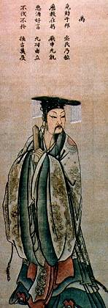
Hsia Dynasty
The Hsia family would have ruled China from around 2200 BCE until around 1800 BCE. They are believed to have been Aryans, who migrated into the area, and who were able to conquer the local peoples using their superior weaponry and technology.
Yu, the Great – Founder of the Hsia

Slide 18
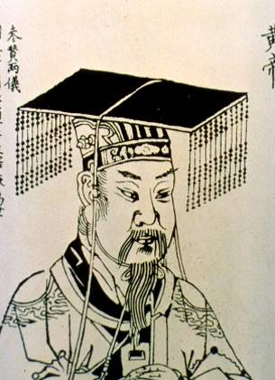
“Huangdi” – Emperor
The “Yellow Emperor.”
Legend has it that he ruled for over 100 years.
Associated with the invention of wheeled vehicles, ships, armor, pottery, and silk-making.

Slide 19
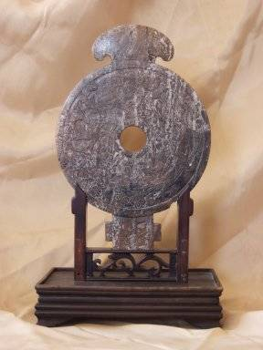
Hsia Plaque, 1700 BCE

Slide 20
Shang Dynasty
1766-1027 BCE

Slide 21
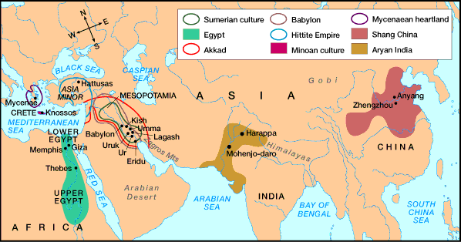
Bronze Age Empires

Slide 22
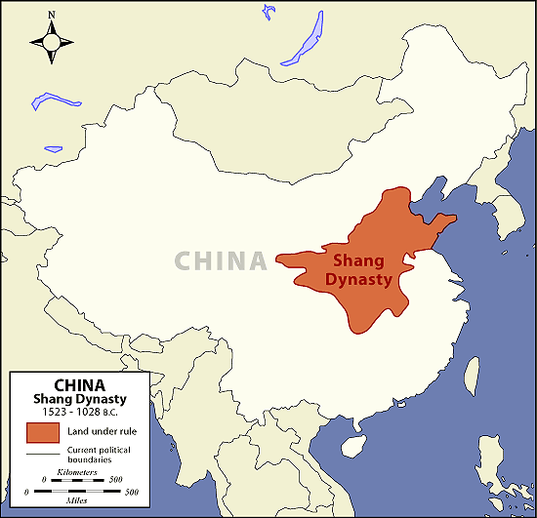
Shang: 1523-1028 BCE

Slide 23
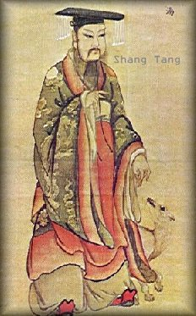
The Shang Dynasty
Like the Hsia Dynasty, the Shang Dynasty was once thought to be only a myth or legend. It is now considered by all historians as a true dynasty. Because many historians do not consider the Hsia Dynasty a true dynasty, the Shang Dynasty is often called the first true Chinese dynasty.

Slide 24
Shang Rule: 1766 – 1100 BCE
The Shang Dynasty ruled China from around 1766 BCE until 1100 BCE. During this 400 year period of history, Chinese tradition states that 30 separate kings ruled from a succession of seven different capitals.

Slide 25
The Shang
The Shang left written records and extensive material remains, especially bronze works.
Bronze metallurgy, horses, chariots, and other wheeled vehicles came to China with Indo-European migrants.
The Shang employed artisans to make many weapons for the government.
They controlled access to copper and tin ores.
Notes:
This bronze ritual wine vessel, dating from the Shang Dynasty in the 13th century BC, is housed at the Arthur M. Sackler Gallery of the Smithsonian Institution.

Slide 26
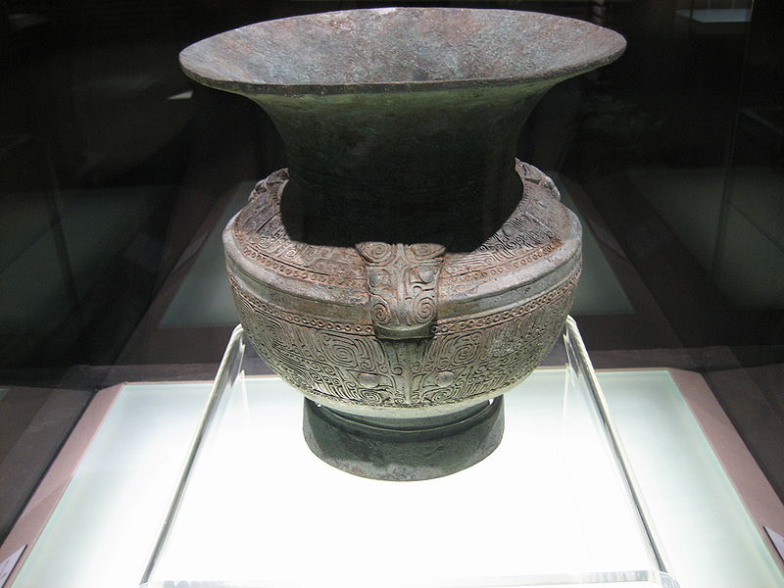
The Shang
The Shang kings had many political allies who supported the king in exchange for agricultural output and access to metal works.
Several large cities were highly fortified with thick, tall walls.
This indicates a highly centralized political power and central rule of the Shang kings.
Shang zun (wine vessel)
Made of Bronze

Slide 27
What was special about the Shang?
Shang China had limited contact with the rest of the world, though it did trade with Mesopotamia, a very long journey.
The Shang were so isolated that they believed themselves to be at the center of the world.
The Shang had an ethnocentric attitude which means they considered themselves superior to all others.
The Shang were accomplished bronze workers, used horse-drawn chariots, developed the spoked wheel, and became experts in the production of pottery and silk.
They also devised a decimal system and a highly accurate calendar.

Slide 28
Political and Religious Organization of the Shang -1
Ruled by specific internal clans, each with its own king.
Kingship and kinship were linked.
As head of his biological clan and geographical realm, the king:
Performed rituals and sacrifices
Waged war
Constructed irrigation and flood control
Administered the government.
Was thought to be descended from the god of the spirits.
Had divine rights.

Slide 29
Political and Religious Organization of the Shang - 2
The ruler directly controlled a growing network of towns.
He ruled from his capital city.
He designated representatives to oversee regional cities. Most of these representatives were blood relatives.
These relatives received title to land, shares in the harvests, and rights to build and control the regional capital cities.
In exchange, they represented and served the king and his interests in the provinces.

Slide 30
Class Organization under the Shang
Inside the walled area lived the royal family, the nobility, and their retainers.
Outside this palace was a network of residential areas.
To the north were the dwellings and graves of the wealthy and powerful marked by ritual bronze vessels and sacrificial victims.
To the south were the dwellings of the commoners and their burial places in trash pits.
Occupations were inherited within specific family units.
Many “zu” or lineage groups corresponded to occupational groups.

Slide 31
Women in Ancient China
There was some evidence that women had power in the earliest of Chinese dynasties.
By the time of the Shang dynasty, however, all evidence points to China as a very patriarchal society wherein women had fewer options than men.

Slide 32
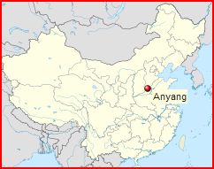
Anyang: The Last Shang Capital
The final, most powerful capital of the Shang dynasty was at Anyang.
This capital was the center of a network of sites stretching about 200 miles.
Though the area has been pillaged and farmed for years, there have been some discoveries that include bronze treasures in royal graves.
The Shang produced bronze axes, knives, spears and arrowheads as well as bronze utensils, ritual vessels, and sculptures.
They used horse-drawn chariots, which may have been derived from the Indo-Europeans who migrated into China.

Slide 33
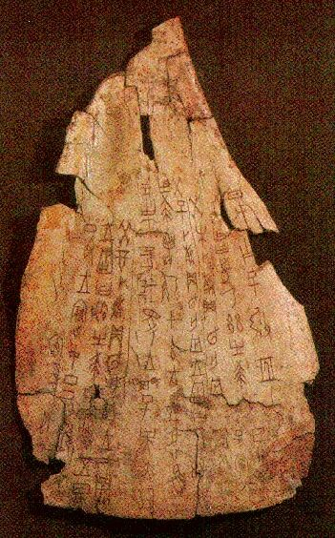
Early Evidence of Writing
Oracle bones - bones of birds, animals, and shells of turtles - were inscribed with markings and writings for use in predicting the future.
After they were marked, these bones were placed in a fire and tapped lightly with a rod until they began to crack.
The crackers were then interpreted by specialists in predicting the future.

Slide 34
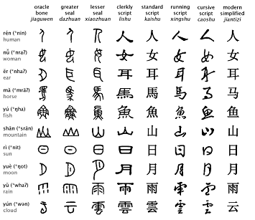
Invention of Writing
One of the most important contributions made during the period that the Shang Dynasty ruled China was the invention of writing. The earliest written records found in China come from this time period.

Slide 35
The Evolution of Chinese Writing during the Shang
Pictographs
Semantic-Phonetics

Slide 36
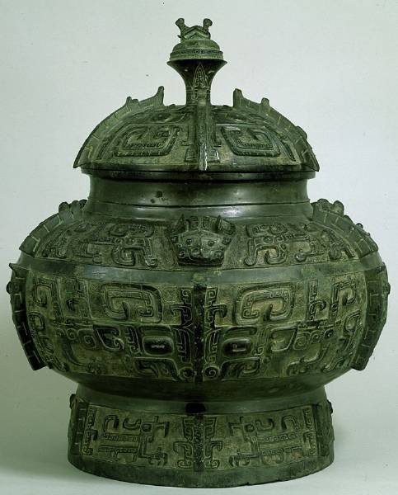
Shang Urn

Slide 37
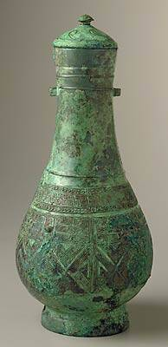
Ritual Wine Vessel – bronze, 13th cent. BCE

Slide 38
Zhou Dynasty
1027 - 256 BCE

Slide 39
The Zhou Dynasty
The Zhou Dynasty developed along the Wei River in NW China.
One of the most important written sources for Zhou political thought is the Book of Documents, which describes the Zhou conquest of the Shang.
The Zhou portray a corrupt Shang king who succumbed to wine, women, and greed.
They claimed that the Shang Dynasty had lost the Mandate of Heaven due to their poor governing
The Zhou dynasty lasted from 1122 BCE until 256 BCE, the longest lasting dynasty in Chinese history.
Notes:
The book consists of 58 chapters (including eight subsections), of which 33 are generally considered authentic works of the 6th century BC. The first five chapters of the book purport to preserve the sayings and recall the deeds of such illustrious emperors as Yao and Shun, who reigned during legendary age; the next 4 are devoted to the Xia Dynasty, the historicity of which has not been definitively established; the next 17 chapters deal with the Shang Dynasty and its collapse. The blame for this is placed on the last Shang ruler, who is described as oppressive, murderous, extravagant, and lustful. The final 32 chapters cover the Zhou Dynasty until the reign of Duke Mu of Qin. It contains examples of early Chinese prose, and is generally considered one of the Five Classics. The Classic of History is possibly the earliest narrative of China, and may predate the Historiai of Herodotus as a history by a century. Many citations of the Shangshu can be found in the bamboo slips texts from the tombs of Guodian, in Hubei, dated to the 300 BC. In July 2008, Zhao Weiguo, an alumnus of Tsinghua University donated a collection of 2100 bamboo slips to his alma mater after obtaining them through auction in Hong Kong. The previous owner and the slips' whereabouts have not been revealed. In the collection, the Shangshu is one of the historical books. According to expert Li Xueqin, the collection dates to the Warring States Period from Hubei, the homeland of Chu.
Bamboo and wooden slips (simplified Chinese: 简牍; pinyin: jiăndú) were one of the main media for literacy in early China, and then subsequently in medieval Japan. The long, narrow strips of wood or bamboo typically carry a single column of brush-written text each, with space for several tens of Chinese characters. For longer texts, many slips may be bound together in sequence with thread.

Slide 40
“T’ien Ming”
The Mandate of Heaven
The Mandate of Heaven developed during the Zhou Dynasty and dominated Chinese thought well into the 20th Century.
It is based on four principles:
The right to rule is granted by Heaven.
There is only one Heaven; therefore, there can be only one ruler.
The right to rule is based on the virtue of the ruler, which serves as a check on the ruler's power.
The right to rule is not limited to one dynasty, which justifies rebellion as long as the rebellion is successful.

Slide 41
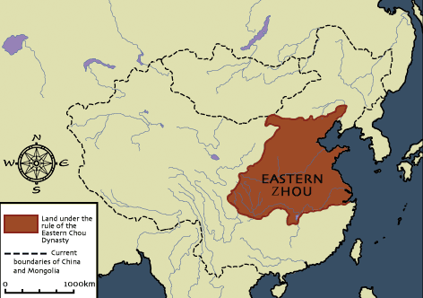
Zhou Expansion
The Zhou set up a new economy, rearranging the affairs of the kingdom. As they did so, the borders of their kingdom swelled, and they were able to maintain control over the people they conquered effectively.

Slide 42
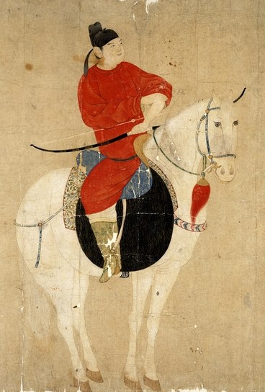
Zhou Regional Rulers
Zhou kings assigned noblemen, who were usually members of the royal family, to serve as regional rulers. These noblemen owned the land, and were given absolute authority over it. The peasants could not own land, but instead worked the land for the noblemen. This form of government worked well for several hundred years. However, overtime the king slowly became less powerful, while the noblemen grew in power

Slide 43
Zhou’s Contributions to Chinese Culture
The Zhou transformed warfare.
They developed the cavalry in which soldiers fought with bows and arrows on horseback.
They introduced infantry troops of draft foot soldiers.
The Zhou expanded significantly, creating a much larger state than what had been ruled by the Shang.
The Zhou created a decentralized administration that left much power in local hands.

Slide 44
Zhou Dynasty Overthrown
In 771 BCE, while fighting against a rebellion, the Zhou armies suffered a terrible defeat. As a result, the Zhou Dynasty lost even more power to the noblemen. They managed to hang on to power for another 500 years. The last years of the Zhou Dynasty are known as the Period of Warring States. Then in 256 BCE the Zhou Dynasty was finally overthrown.

Slide 45
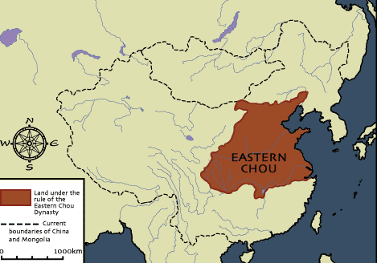
Eastern Zhou: 771-256 BCE

Slide 46
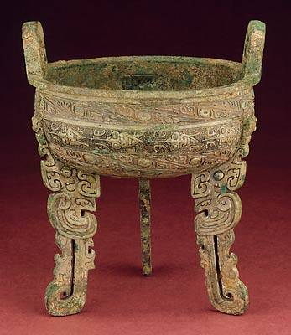
Ritual Food Vessel, bronze 11th cent. BCE (Western Zhou)

Slide 47
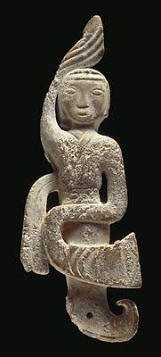
Pendant of a Dancer - jade 3th cent. BCE (Eastern Zhou)

Slide 48
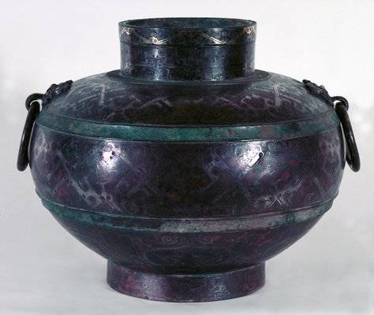
Ritual Wine Vessel (Lei) bronze, silver, gold, copper – end of 4th cent. BCE

Slide 49
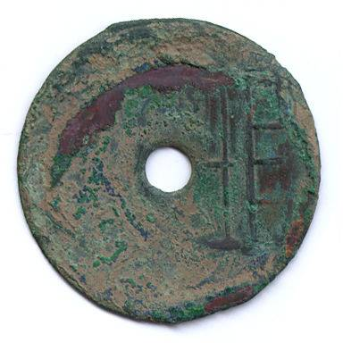
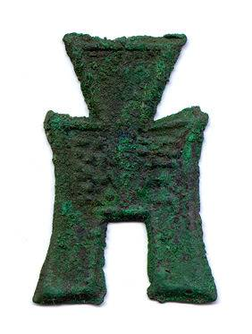
Zhou Coins - bronze

Slide 50
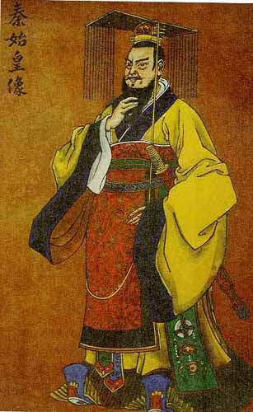
The Qin Dynasty
By 221 BCE a man by the name of Qin had overthrown all remaining members of the Zhou Dynasty, and all other opposition, allowing him to place himself as the ruler of China.

Slide 51
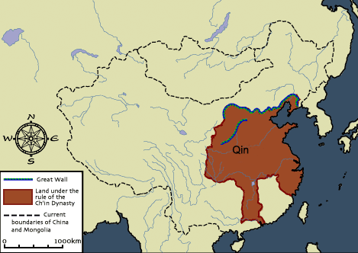
“China”: Derivative of “Qin”
The Qin Dynasty would only last about 11 years. Yet during these short years, this dynasty would make changes that would effect the history of China for thousands of years. So influential was Qin, that the name of the nation, China, is a derivative of his name.

Slide 52
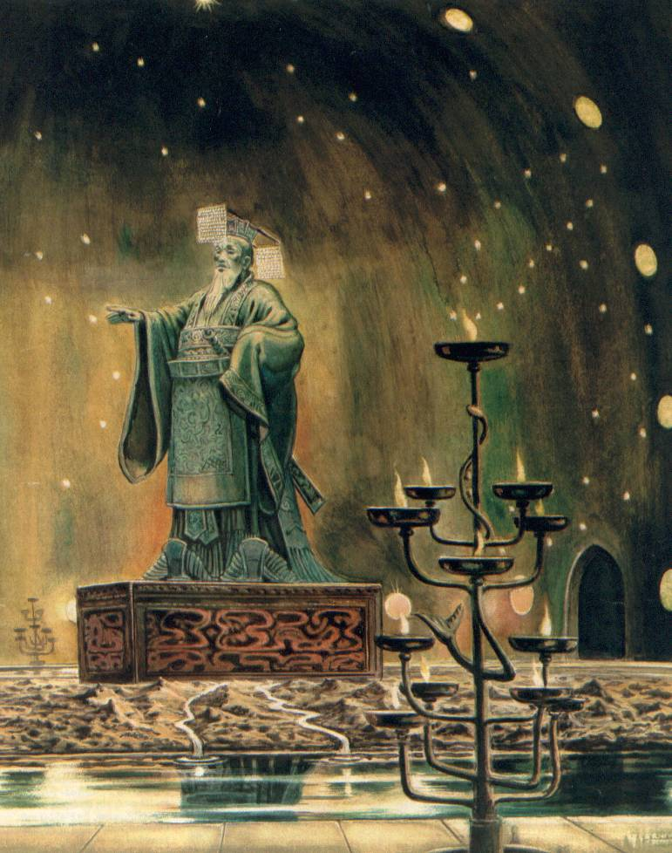
Qin Shihuangd – The Centralization of Authority
In order to show his importance and power, Qin added a new name to his own. He began calling himself Qin Shihuangdi, which means Qin, the first emperor of China. Qin again reorganized the affairs of China. Instead of a system of nobleman, Qin wanted everything to be under his direct authority and control

Slide 53
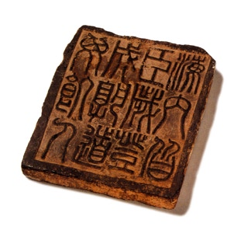
Written Laws
He established a strict set of written laws that were recognized throughout China, and setup military control in each region of China so that local noblemen could not rebel against the emperor.
All people are subject to me, Every field harvest, and Everyone can have enough food.

Slide 54
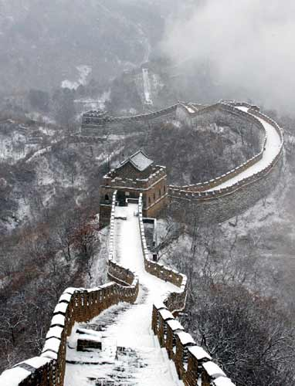
Qin Building Projects
To make China the most glorious nation on Earth, Qin needed labor. He used the peasants, forcing them to work under slave conditions, so that he could build roads, bridges, canals, buildings, and his most famous building project of all, the Great Wall of China.

Slide 55
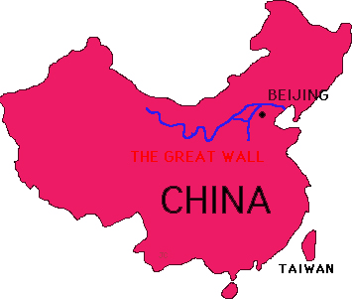
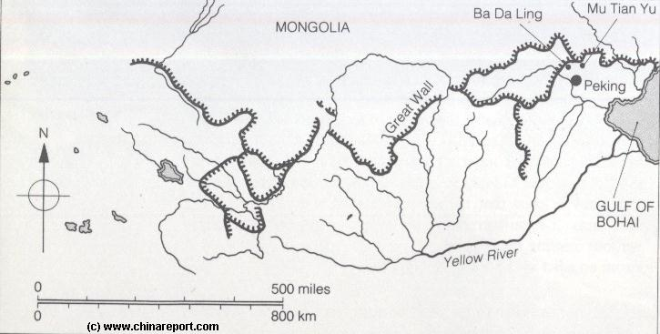
The Great Wall of China
Early emperors had built walls in the northern territories to protect their nation against attack from outside forces. These walls were spread across the landscape, and not connected. Qin ordered his people to connect the existing walls together, and to expand them, eventually covering a distance of over 4000 miles.
THE GREAT WALL

Slide 56
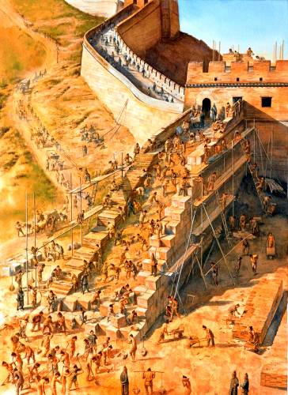
Peasant Labor
Over 300,000 peasants were forced to help build the Great Wall of China. Many of them died during the construction. After working for several years, the Great Wall of China was completed, and still stands today as one of the great building projects in human history.

Slide 57
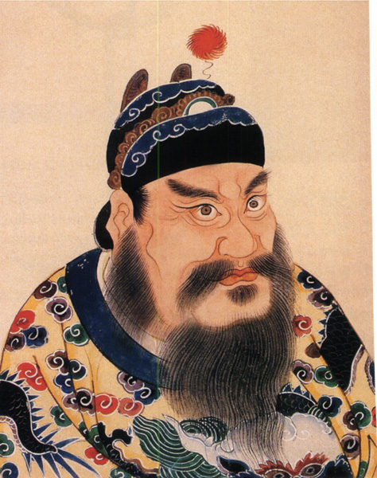
The Han Dynasty
In the year 207 B.C. a new dynasty began to rule China. This dynasty was led by a peasant whose name was Liu Bang. Liu Bang had grown tired of the brutal leadership of the Qin Dynasty. Many other people also were tired of the Qin
Peace thru war and plunder.

Slide 58
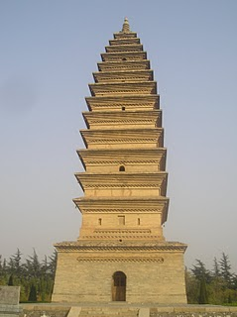
Mandate of Heaven
Liu Bang proclaimed that the Qin had lost the Mandate of Heaven, or the right to rule the nation. He was able to overthrow them, and establish himself as the new emperor of China, and the first emperor of the Han Dynasty.

Slide 59
Start here→
A new dynasty comes to power.
The emperor reforms the govt. & makes it more efficient.
Emperor is defeated !!
Lives of common people improved; taxes reduced; farming encouraged.
The Dynastic Cycle
Rebel bands find strong leader who unites them. Attack the emperor.
Problems begin (extensive wars, invasions, etc.)
Poor lose respect for govt. They join rebels & attack landlords.
Taxes increase; men forced to work for army. Farming neglected.
Droughts, floods, famines occur.
Govt. increases spending; corruption.

Slide 60
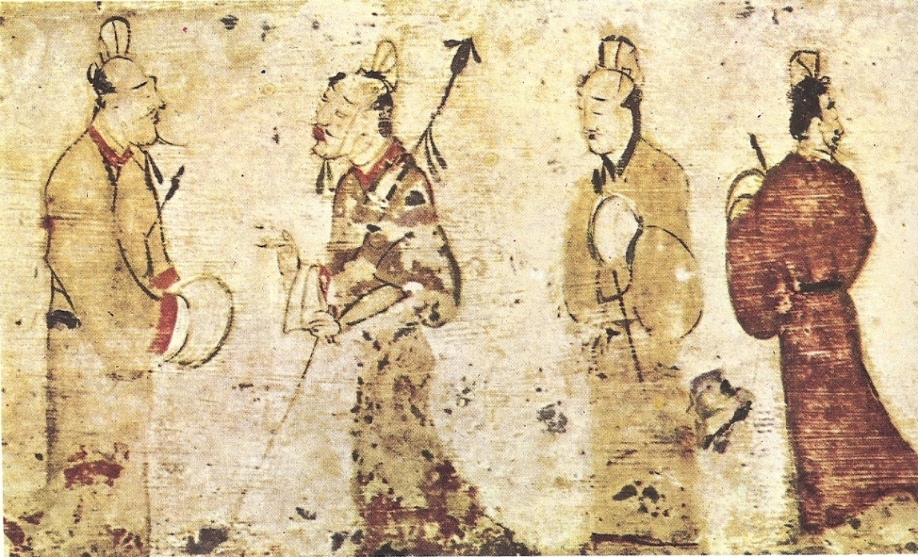
Four Hundred Year Rule
The Han Dynasty would rule China for the next 400 years. During this time period they would be one of the wealthiest and most powerful nations on Earth. Their achievements would only be surpassed by the Roman Empire.

Slide 61
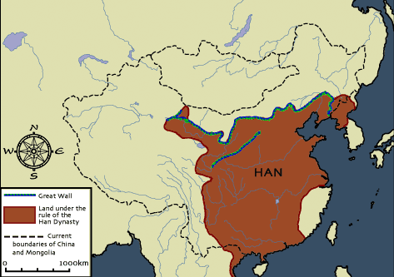
Isolated from Rest of the World
Because of its location amidst high mountains and surrounded on many sides by water, China was isolated from much of the rest of the world. As their civilization flourished and their wealth increased, they were largely unaware of what advancements were taking place in the nations around them.

Slide 62
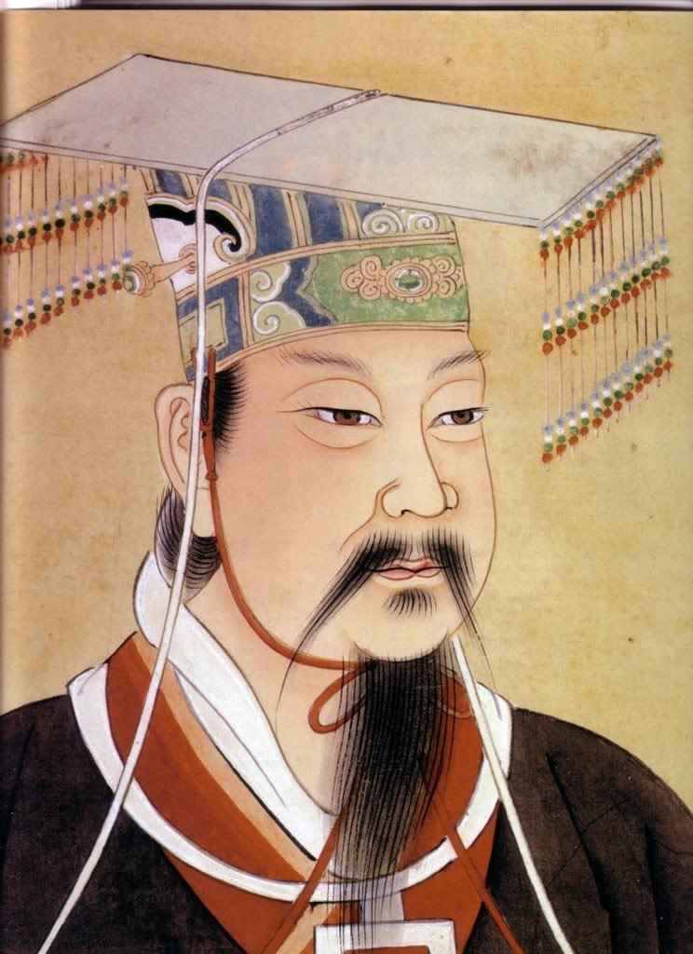
Chinese Exploration
In 139 BCE, a Han emperor by the name of Wudi sent out one of his generals, Zhang Qian, to explore other nations. This general and his army marched throughout distant regions visiting other civilizations and nomadic tribes.

Slide 63
Attacked by Nomadic Tribes
The armies of Zhang Qian were viewed as a threat by many of these nomadic tribes, as a result, these tribes attacked and destroyed many of Zhang Qian's men. Zhang Qian himself was captured and kept in bondage for a period of 10 years. After 13 years, Zhang Qian was finally able to return to the emperor and report.

Slide 64
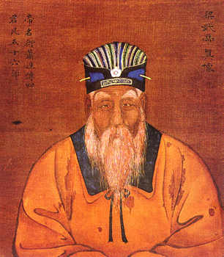
Wudi Aspires to Trade with West
He told Wudi about stories he had heard from the nomadic tribes of a great civilization to the West that equaled the glory of China. This was the first time Wudi had heard anything of any other civilizations. Wudi was a smart and wise ruler, who saw the potential for trade between the two cultures.

Slide 65
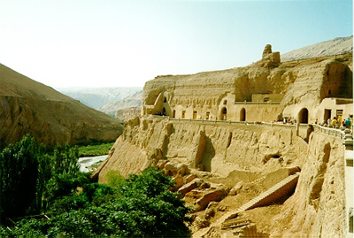
The Silk Road
In order to make trade possible , Emperor Wudi began to develop what has been called in modern times, the silk road. Following this route merchant traders took silk from China to the West, and brought glass, linen, and gold back to China.

Slide 66
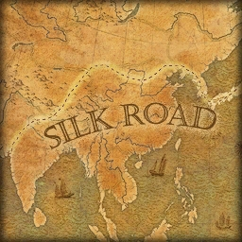
Trails, Roads, Bridges
The silk road consisted of trails, roads, bridges, and pathways that stretched across nearly 5000 miles of land and water. The silk road is not one long road, but rather many smaller roads and pathways that were connected, and worn by the use of thousands of travelers over a period of hundreds of years.

Slide 67
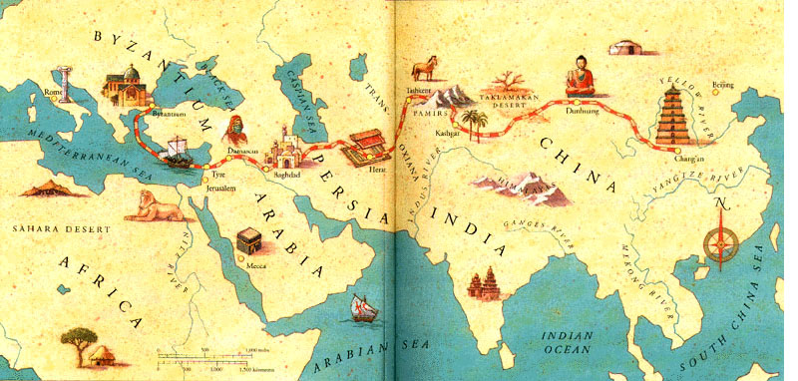
Expansion of Trade
The silk road would become instrumental in the development and expansion of trade, and the accumulation of wealth in both China and Rome, as well as in Egypt and other nations.

Slide 68
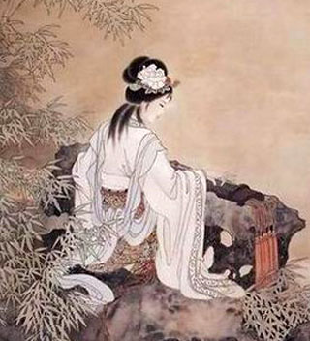
Pax Sinica
During the rule of the Han emperors, China enjoyed a 400 year period of peace and prosperity. During this time, the Han emperors established a strong central government that was designed to help the people, and protect them.

Slide 69
Food Reserves
One such innovation was the storage of food. During times of plenty, Han emperors would have great amounts of food put up into storage. Then during difficult times, they would sell these food stores, helping to stabilize food prices.

Slide 70
Merit-Based Appointments
The Han also abolished the practice of giving powerful government positions to members of the royal family. Emperor Wudi instituted a series of written exams. Anyone could take the tests. Those who received the highest scores were given posts in the government.

Slide 71
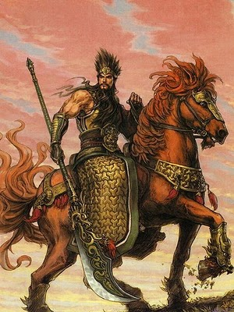
The End of the Han Dynasty
By C.E. 220 the Han Dynasty had fallen into a weakened state. Warriors from competing areas began fighting one another, throwing China into a period of civil war that would last for many years.

Slide 72
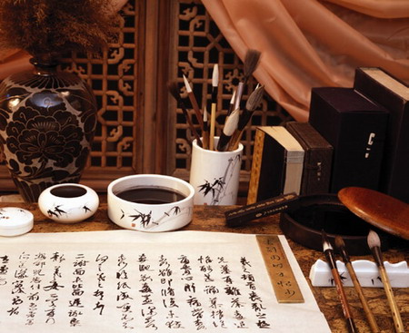
Enduring Contributions
Even though the Han Dynasty had ended, many of the contributions made by this dynasty would become interwoven into Chinese culture, and would endure through the ages to modern times.

Slide 73
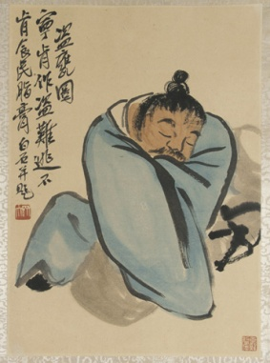
Chinese Dynasties and Their Achievements
Dynasties | Notable Rulers | Achievements
Xia Dynasty 2100-1800 BCE | Aryans | Migrated into the area and conquered the local peoples Developed superior weaponry and technology
Shang Dynasty 1500-1100 BCE | Thirty separate kings | Ruled from a succession of seven different capitals. Invention of writing
Zhou Dynasty 1122-256 BCE | Kings + Noblemen | Expansion Regional rulers
Qin Dynasty 221-206 BCE | Qin | Centralization of authority Written laws Building projects (Great Wall of China)
Han Dynasty | Han Wudi | 400 year rule Exploration (Zhang Qian) Expansion of trade Silk Road Pax Sinica Food reserves Merit-based appointments

